Slide 1
Accelerated Reader 30th September 2021

Slide 2
Our reading intent at Lanchester EP
Learning to read is one of the most important things your child will learn at our school. Everything else depends on it, so we put as much energy as we possibly can into making sure that every single child learns to read as quickly as possible.

Slide 3
What we want to achieve.
Children who love to read and are inspired to become lifelong readers
Children who can read accurately and fluently and with understanding
Children who can read with expression, clarity and confidence
Children who can read fluently in any subject ready for their secondary education
Children who develop a deeper level of emotional intelligence and empathy through reading widely

Slide 4
Reading at Lanchester EP
A new systematic phonics scheme – Sounds Write
A new approach to Home School Reading – Accelerated reader
Sets of carefully selected class readers which will inspire children to read and deal with a range of current issues
High quality and engaging texts to support the teaching of the wider curriculum

Slide 5
Why Accelerated Reader?
Helps children make rapid progress in reading
Targets reading enjoyment and helps children establish a love of reading
Gives children more freedom to choose what they read
Gives children more ownership of their own reading
Targets and improves comprehension
Gives children a zone to read in rather than a level

Slide 6
What is Accelerated Reader?
A computer program that helps teachers manage and monitor children’s independent reading practice
After children have read a book they complete a computer quiz which assesses how well they have understood the book.
Children earn points for completing quizzes
Teachers can use data from the reading quizzes to get a comprehensive understanding of reading progress and set targets

Slide 7
Before starting Accelerated Reader children complete a Star Reading Assessment. This analyses their reading accuracy but also their understanding of vocabulary and inference skills.

Slide 11
ZPD
The results of the Star Reader Assessment give the children a ZPD.
ZPD is the range of books that will challenge a child without causing frustration or loss of motivation.
The ZPD is not a level it is a range in which children can pick books from.

Slide 13
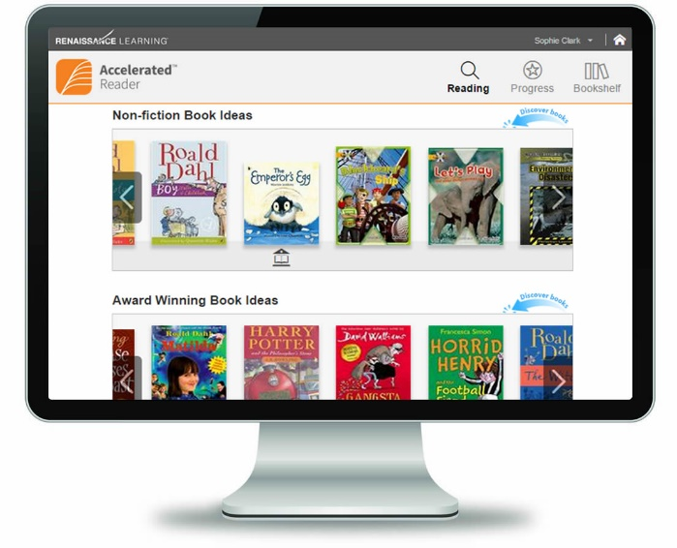
Each child has started at the bottom of their ZPD so are reading books which they may find easy. Don’t worry if it seems they are bringing easier books home to read. The teacher monitors their quiz scores and can move them up once they have a done a few quizzes.

Slide 14
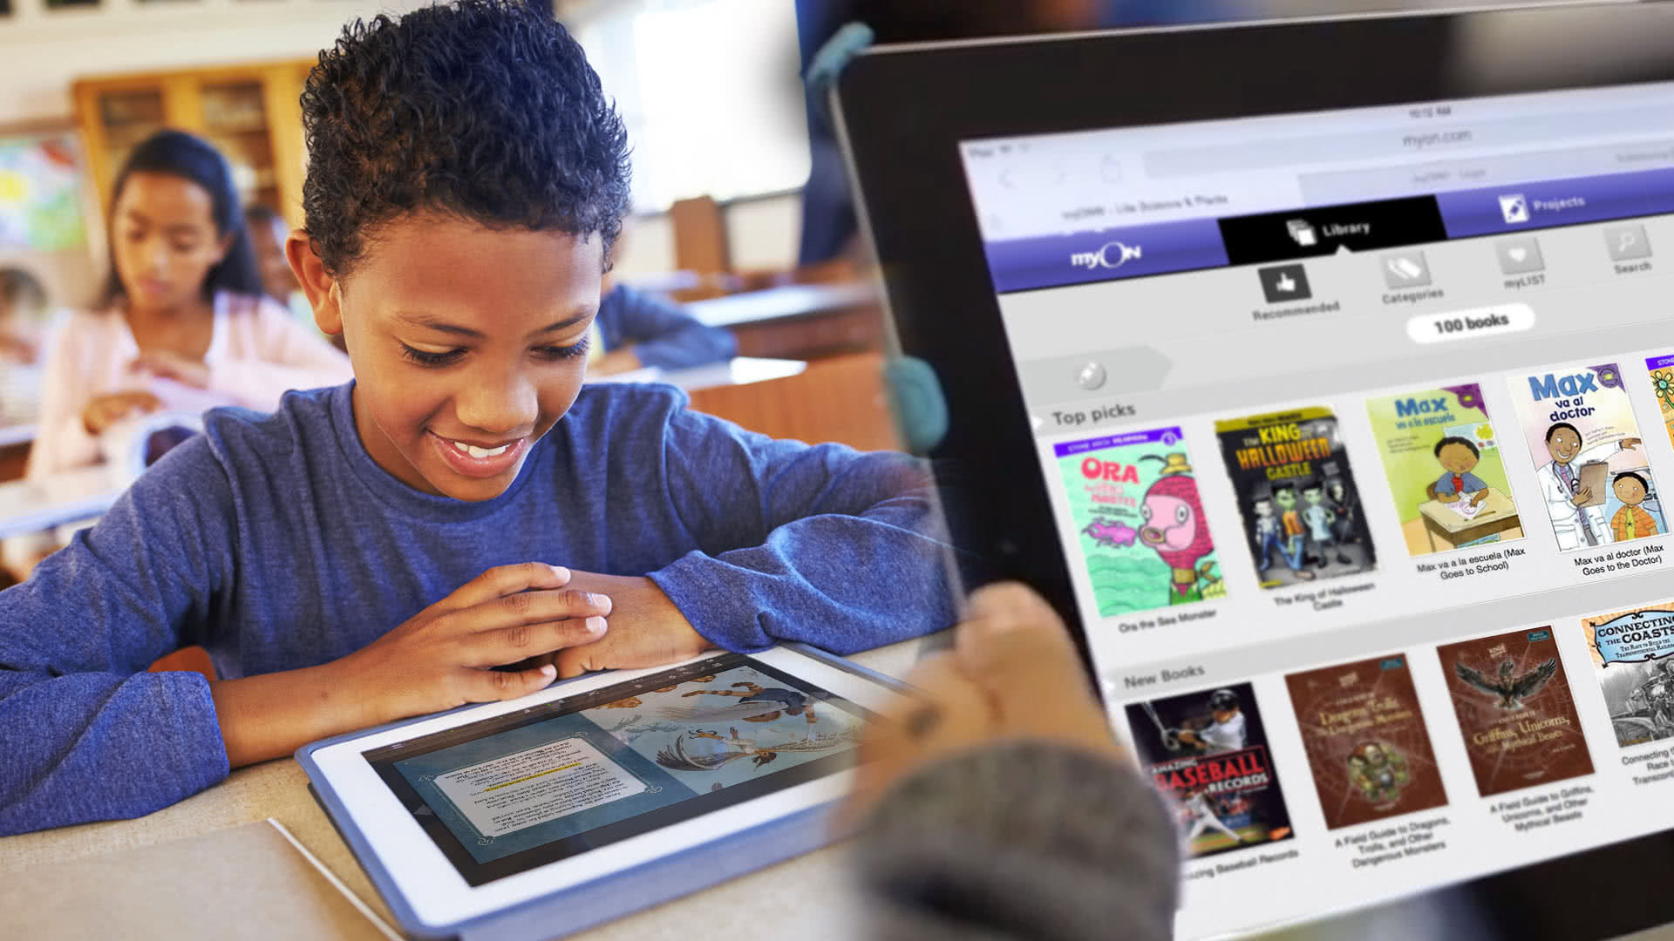
Once children have read a book, they take a computer quiz on the book. This quiz assesses the children's understanding of what they have read. Teachers monitor quiz results to check childrens progress and move them up or down their ZPD range.

Slide 18
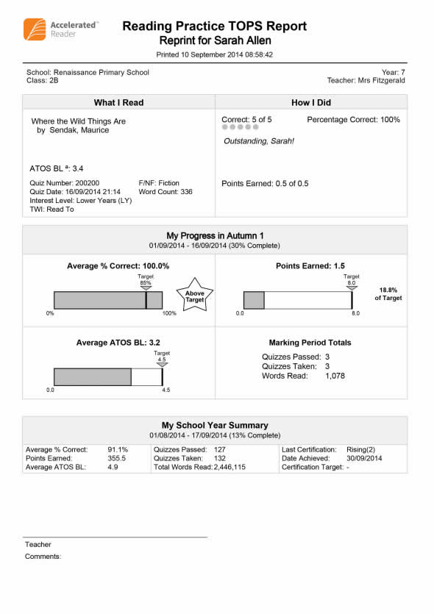

Slide 19
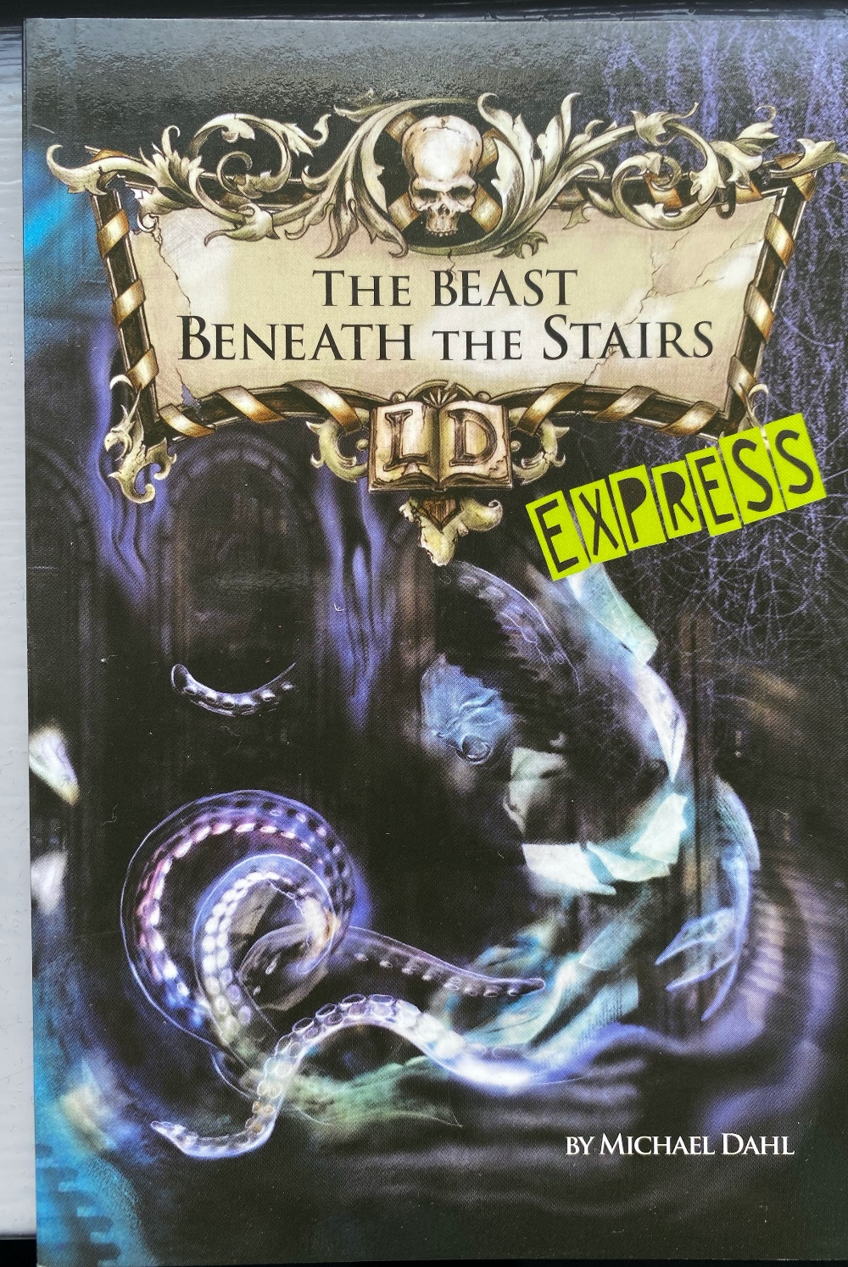
New reading books for older children who struggle to read

Slide 20
Children will complete a new Star Reader Assessment at the end of each half term and a new ZPD will be given to each child.

Slide 21
How much will my child read during the school day?
According to research, children who read at least 35 minutes a day with a 90% comprehension rate (average percent correct) on Accelerated Reader quizzes see the greatest gains.
In school we have the first 35-40 minutes of every day set aside for Accelerated Reader.
During this time children will either be reading silently, reading with an adult in the class or completing an accelerated reader quiz.

Slide 22
How can I help my child become a better reader?
As with anything, performance improves with practice. Encourage your child to read at home. Create a culture of reading in your household by reading with your child, starting a home library, visiting your local library or bookstore on a regular basis, letting your child see you reading, and discussing books that each of you has read.
When reading with your child, stop and ask questions to be sure your child is comprehending what is read.
Reading with your child, no matter what the child’s age, is an important part of developing a good reader, building a lifelong love of reading and learning, and creating a loving relationship between you and your child.

Slide 23
What can my child read at home?
Children should be encouraged to read as widely as possible. It is fine if children want to read other books outside of their Accelerated Reader Book.
You can visit arbookfind.com and click on Advanced Search to find books in your child's ZPD. If you are reading with or to your child at night feel free to read above or outside of their ZPD. The most important thing is children should enjoy their reading!!

Slide 24
What if my child doesn’t like reading?
Using Accelerated Reader, your child will choose the books he wants to read. The teacher will make certain the book is at the right level so that after completing the book, your child should do well on the Accelerated Reader Reading Practice Quiz.
Success on the quiz will encourage your child to read more. With guidance from the teacher, and success, even students who say they don’t like reading will develop a love of reading.

Slide 25
Any other questions?

