Slide 1
Moving on….
From Reception to Year 1

Slide 2
What’s important when children move on?
Making sure the children feel confident and settled.
Keeping children interested and motivated to learn.
Continuing the learning journey with minimum disruption.
We know that happy children learn best.

Slide 3
How do we support your child’s transition?
Reception coming to Assembly
Reception playing on the Year 1 Playground
Moving up Day
Calling in for Story Time
Evidence Me

Slide 4
Year 1 Staff
Mr Innes Mrs Burke
Miss Honan Mrs Clarke

Slide 5
What will it be like in Year 1?
The children will learn in an active way that is appropriate to their developmental needs.
Teaching of ‘National Curriculum’ subjects will include lots of practical activities.
The children will have opportunities to learn through their own play so that they remain interested and motivated.
The children will be building upon the skills of independence they have developed in Reception.
The children will take part in guided groups and build on their prior learning.

Slide 6
Year 1 Curriculum
The curriculum is largely influenced by Reception and as mentioned builds on the skills they have already learnt.
We work from children’s input and questions to adapt teaching and learning.
Activities are mostly practical and opportunities for learning outside the classroom happen where possible.
Promotion of the child as an independent learner in the curriculum.
We continue to work with themes and topics that interest the children.

Slide 7
A comparison between EYFS and Y1 curriculum
Reception: Personal, Social and Emotional Development
Year 1: PSHCE (personal, social, health and citizenship education) and R.E.
Reception: Literacy
Year 1: Reading and Writing
Reception: Mathematics
Year 1: Maths
Reception: Understanding the World
Year 1: Science, History, Geography, D&T, ICT and R.E
Reception: Expressive Arts and Design
Year 1: Art and Design, Dance, Drama and Music
Reception: Physical Development
Year 1: P.E, Writing

Slide 8
Year 1 Topic Overview

Slide 9
Expected progress in writing
Expected in Reception: Children can write recognisable letters, most of which are correctly formed. Spelling words by identifying sounds in them and representing the sounds with a letter or letters. Write simple phrases and sentences that can be read by others.
Expected in Year 1:
Children have good handwriting skills. Their sentences are well structured and make sense. They use finger spaces, capital letters and full stops. They are using adjectives, interesting language and the word ‘and’ to write longer sentences.

Slide 10
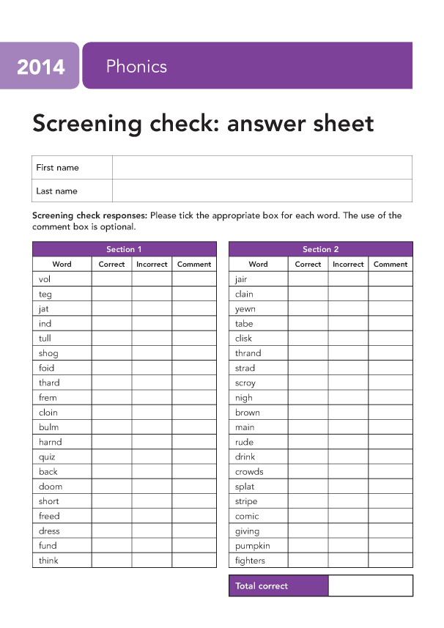
The Phonics Screening
There will be a strong focus on Phonics and Reading throughout Year 1.
We will follow our scheme to provide a structured and systematic approach to teaching English.
The new National Curriculum emphasises the importance of children learning to read using a phonics based approach.
Children will learn the phonetic sounds to help them blend and read the words.
Teaching them the right phonics skills will ensure they become successful readers and make them feel confident when taking the Phonics Screening Test at the end of Year 1 in June.
Children will complete the test by reading 40 words. These are a mixture of ‘real’ words and ‘alien’ words. The pass rate has been 32 for the past few years but this may change.

Slide 11
How will Y1 be different?
An increased need to be independent.
e.g. Start and end of the day (managing personal belongings),
tidying away, changing for P.E. , completing independent tasks.
Opportunities for independent play will be reduced and will turn into more structured play and then focused working time.
Children will be given a phonetically decodable Reading ook which will be changed at least once a week. Children will need their book in school every day as adults will read with children as often as possible.

Slide 12
How can I help my child be Year 1 ready?
Talk about the change in a positive way so your child feels as confident as possible in their new class as it can be a big change for a start.
Maths:
Practise counting
Work on number formation
Reading:
Reading daily with your child and encouraging them to sound out words they cannot read fluently.
Reading to your child to expose them to a wide range of books

Slide 13
How can I help my child be Year 1 ready?
Writing
Encourage your child to write in sentences building up to using capital letters, finger spaces and full stops – make it fun and meaningful like a shopping list or letter to your family.
Make sure your child is forming recognisable letters that are sitting on the lines, if your child struggles to hold their pencil work on strengthening their fingers use things such as Lego, Playdough, threading beads or small tools.
Finally, encourage them to be independent, as Year 1 is where children become much more independent in their learning and within school.

Slide 14
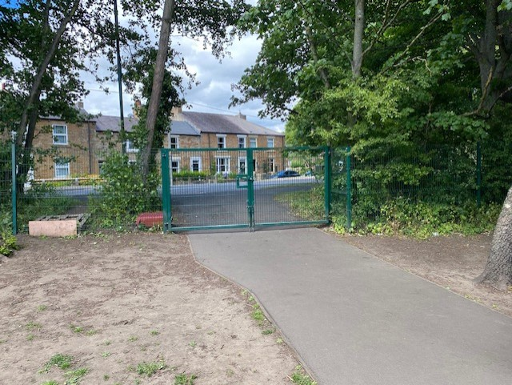
Practical Arrangements
Year 1 Children will enter and leave school through the Field Gate.
The Gates open at 8.30am and all children need to be in school by 8.45am

Slide 15
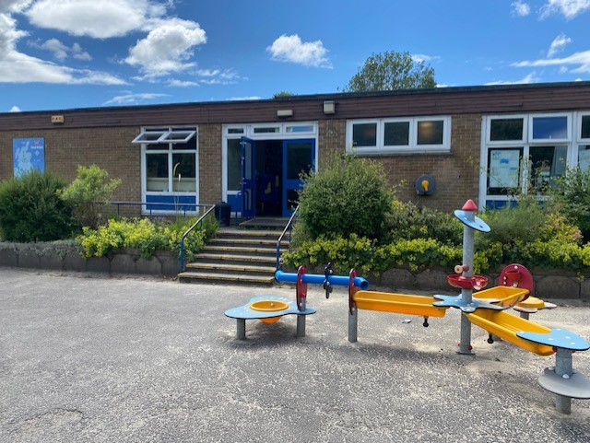
Children will be collected from the KS1 door at 3.15pm

Slide 16
Any Questions?

